Slide 1
Abstract Windows Toolkit (AWT)
And
Java Swing

Slide 2
Abstract Windows Toolkit (AWT): (java.awt) package
The AWT contains numerous classes and methods that allow you to create and manage windows or GUI
will learn how to create and manage windows, manage fonts, output text, etc.
It also explains aspects of Java’s event handling mechanism
Although a common use of the AWT is in applets, it is also used to create stand-alone windows that run in a GUI environment, such as Windows
Although Swings are commonly used today,
AWT is still important, as Swing controls are built on AWT
many aspects of the AWT are also aspects of Swing
many AWT classes are used either directly or indirectly by Swing
Therefore solid knowledge of the AWT is still required

Slide 3
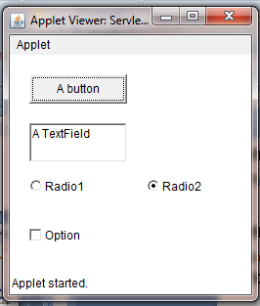

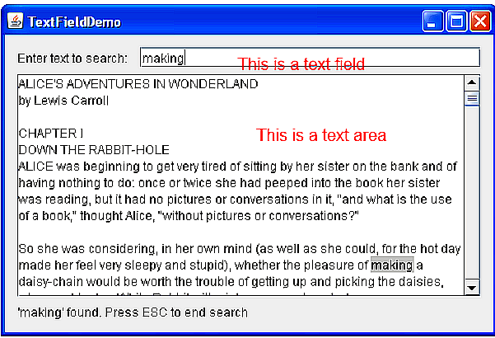
AWT  Class Hierarchy
Some of the classes are as below:
Component
Container
Window
Frame
Choice
Button
Panel
List
Checkbox
Choice
Label
TextComponent
TextField
TextArea

Slide 4
Component
Component is an abstract class that encapsulates all of the attributes of a visual component
Containers
Most windows are a Container that can hold other windows or GUI components.
Containers have a LayoutManager that automatically sizes and positions components that are in the window
Panel
– Purpose
• To group other components into rectangular regions.
Applet is also a Panel
– Code
• Allocate Panel, put other components in it, add to window.
Frame
– Purpose : Core popup window. Main window for your application.
– Code: Allocate Frame, give it a size, add components, pop it up.

Slide 5
Canvas: Reusable drawing area. Basis for custom component. Canvas is not a Container, so cannot enclose components
AWT Components :
are components that allow a user to interact with your application in various ways—for example,
Labels
• Push buttons
• Check boxes
• Choice lists
• Lists
• Scroll bars
• Text editing
Lets add some components to
JApplet as shown
Choice

Slide 6
AWT API is used to display GUI components which is the original toolkit supplied by Java. AWT provides the foundation upon which the rest of the JFC is built. AWT components lack many GUI features which other GUI technologies give. For example, we cannot place an image on the button or change the border of a button. All these are overcome in Swing. Swing adds many features to AWT components. To achieve this, designers added new classes and came out with a special packages javax.swing.

Slide 7
SWING - Overview
Swing API is a set of extensible GUI Components to ease the developer's life to create JAVA based Front End/GUI Applications. It is build on top of AWT API and acts as a replacement of AWT API, since it has almost every control corresponding to AWT controls.
Swing Features
Light Weight − Swing components are independent of native Operating System's API as Swing API controls are rendered mostly using pure JAVA code instead of underlying operating system calls.
Rich Controls − Swing provides a rich set of advanced controls like Tree, TabbedPane, slider, colorpicker, and table controls.
Highly Customizable − Swing controls can be customized in a very easy way as visual appearance is independent of internal representation.
Pluggable look-and-feel − SWING based GUI Application look and feel can be changed at run-time, based on available values.

Slide 8
Differences between AWT and Swing
AWT | Java swing
AWT components are platform-dependent. | Java swing components are platform-independent.
AWT components are heavyweight. | Swing components are lightweight.
AWT doesn't support pluggable look and feel. | Swing supports pluggable look and feel.
AWT provides less components than Swing. | Swing provides more powerful components such as tables, lists, scrollpanes, colorchooser, tabbedpane etc.
AWT doesn't follows MVC(Model View Controller) where model represents data, view represents presentation and controller acts as an interface between model and view. | Swing follows MVC.

Slide 9

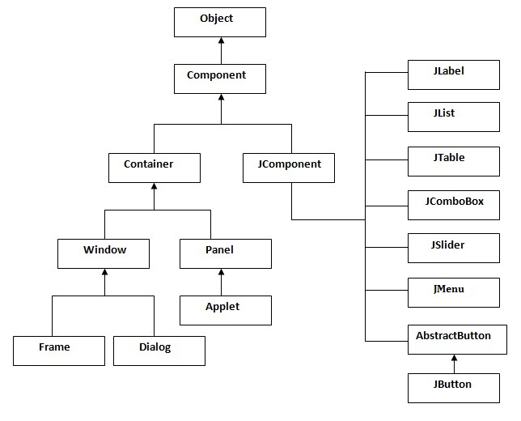

Slide 10
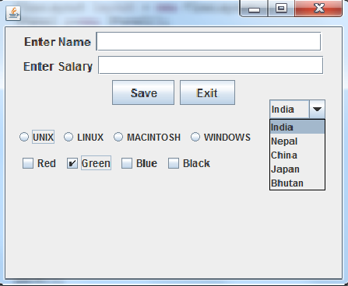
Controls In Java Swings
Are components that allow a user to interact with your application in various ways- for Example
JButton
JLabel
JCheckBox
JRadioButton
JList
JComboBox
JTextFiled
JTextArea
JScrollBar
JTable

